Slide 1
Coordinate Geometry – length of a line between 2 points
L.O. to be able to calculate the length of a line between 2 points on a cartesian plain

Slide 2
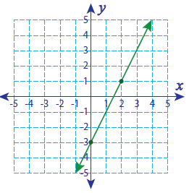
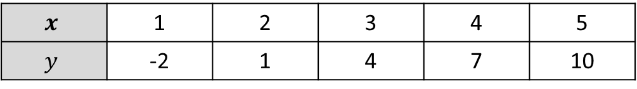

While you are waiting, find the equation of the following. 1) $$y= ________x ______$$ 2) $y= ________x ______$
$$x$$ | 1 | 2 | 3 | 4 | 5
$$y$$ | -2 | 1 | 4 | 7 | 10

Slide 3

Todays feature is called………
Return of the Hypotenuse
Luke, you must learn how to find the distant between 2 points
How?
I can’t learn the ways of the formula, I am not mathematical
I will teach you the ways of the formula.
I can teach you. The cartesian plane needs your help Luke.
But I am too busy to learn the ways of the formula. I have footy practice, rugby, Instagram, snapchat, fortnite to play, youtube cat videos to watch, new music videos to rate….
…..

Slide 4
Who can remember Pythagoras?
What is it?
Where can we use it?
What can we use it on?
On your LHS, you have 2 minutes to write down anything you can remember about Pythagoras.

Slide 5
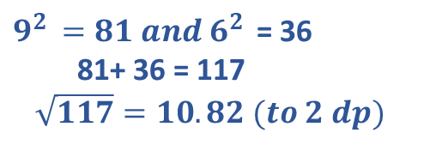
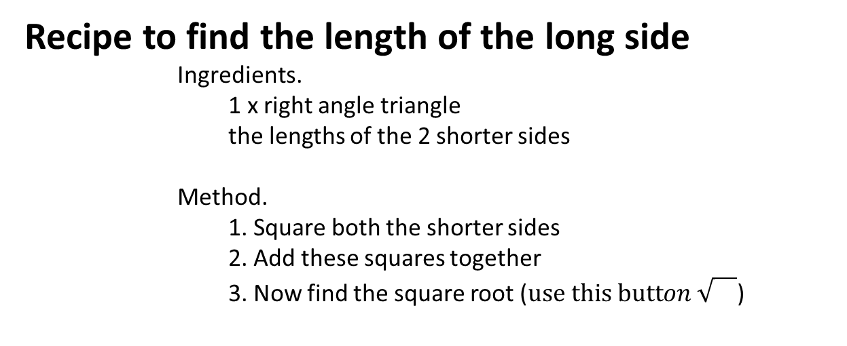
Recipe to find the length of the long side
Ingredients.
1 x right angle triangle
the lengths of the 2 shorter sides
Method.
1. Square both the shorter sides
2. Add these squares together
3. Now find the square root ($use this button \sqrt{}$)
9
$9^{2 }=81 and{ 6}^{2 }$ = 36
81+ 36 = 117
$\sqrt{117}=10.82 (to 2 dp)$
6
Or mathematically we can write Long = $\sqrt{{short}^{2}+ {short}^{2} }$

Slide 6
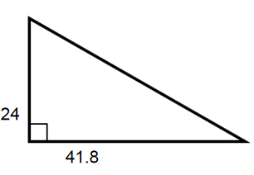
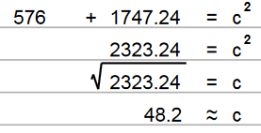



Let’s try
$${short}^{2} + {short}^{2}= {long}^{2}$$
$$b^{2} + a^{2}= c^{2}$$
$${24}^{2} + {41.8}^{2}= c^{2}$$
c
a
b

Slide 7
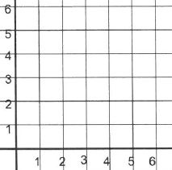
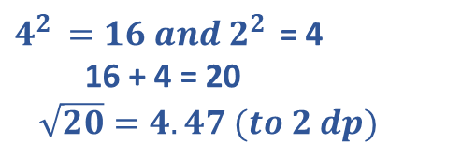


We wish to find the length of the line (the distance) from point A to B.
If we draw lines for the rise and the run - what shape do we get?
What do we call the longest side of the right angled triangle?
B
How can we find the length of the hypotenuse?
$4^{2 }=16 and{ 2}^{2 }$ = 4
16 + 4 = 20
$\sqrt{20}=4.47 (to 2 dp)$
2
A
4
The length of the line is 4.47.
What is an easy way to calculate the rise and the run?
$$run=2nd x value −1st x value$$
5 – 1 = 4
$$rise=2nd y value −1st y value$$
4 – 2 = 2

Slide 8
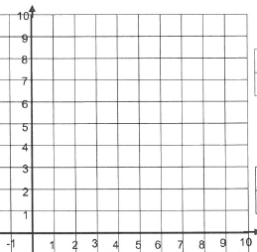
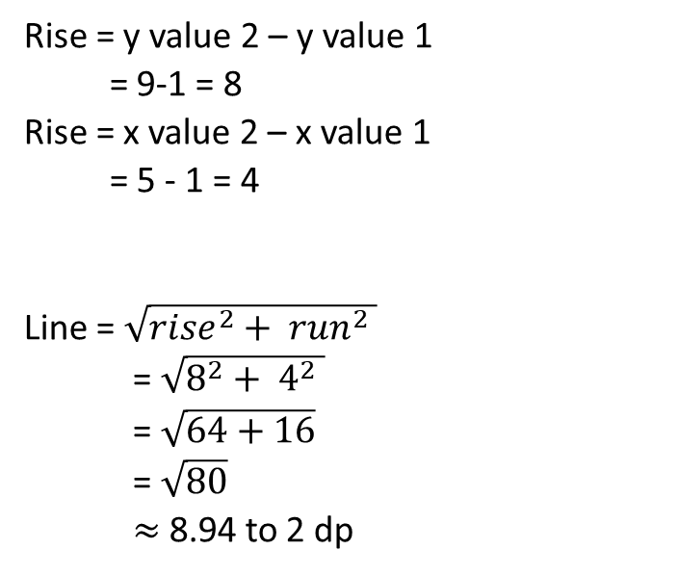
Topic : Pythagoras
24
7
30
Date
EQ : Length of a line on a graph
We can use Pythagoras’ relationship to find the length of a line on a graph.
Rise = y value 2 – y value 1
= 9-1 = 8
Rise = x value 2 – x value 1
= 5 - 1 = 4
Line = $\sqrt{{rise}^{2}+ {run}^{2} }$
= $\sqrt{8^{2}+ 4^{2} }$
= $\sqrt{64+16}$
= $\sqrt{80}$
$≈$ 8.94 to 2 dp
RISE = 8
RUN = 4

Slide 9
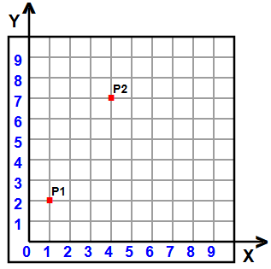
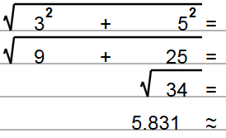
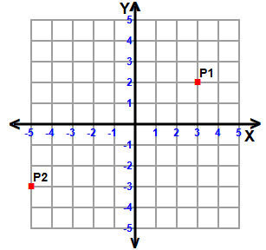
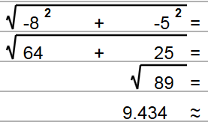
Let’s try these together
Run = 4-1 = 3
Rise = 7-2 = 5
Run = -5 - 3 = -8
Rise = -3-2 = 5

Slide 10
Practice time
Dr Dwyer, Exercise 16.1 on Page 214 - 215

